Slide 1

Book recommendation system-PPT
TEAM 6:
1.M. Lakshmi Manasa
2. K.Dinesh
3. Nehal Sonkusare
4. P. Koushik Kumar Reddy
5. Mansi Bhagwat Ghive
Team 6:
1.
2.
3.
4.
5.

Slide 2
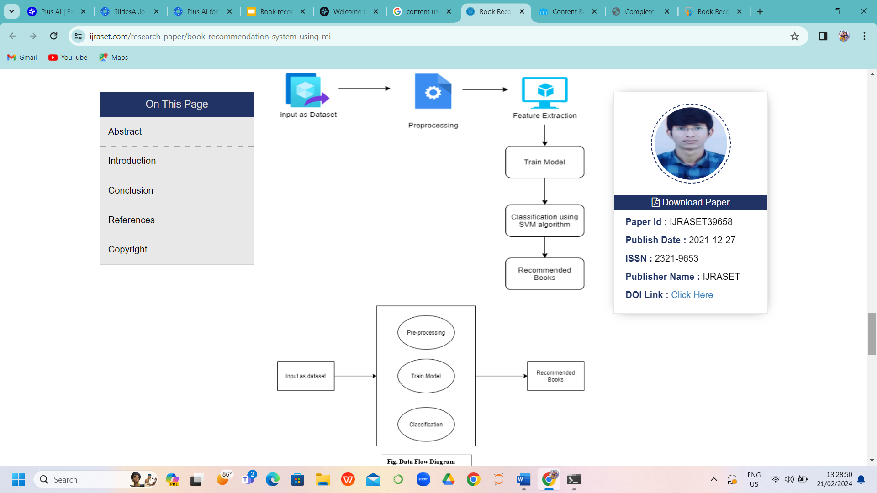
Content used
1.Project Architecture.
2.Project Goal.
3.Dataset Details.
4. Data Pre-processing and EDA
5.Visualization.
6. Model building
7. Model deployment

Slide 3
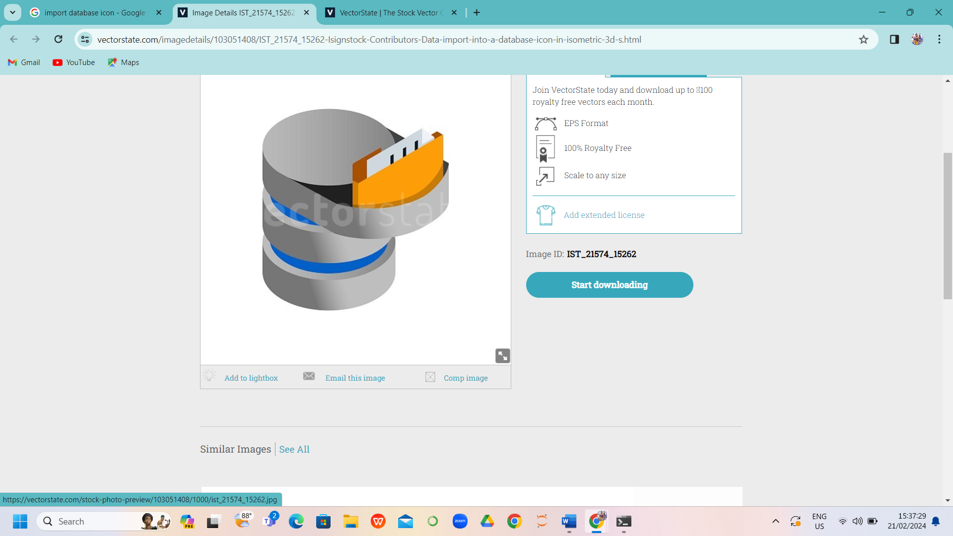


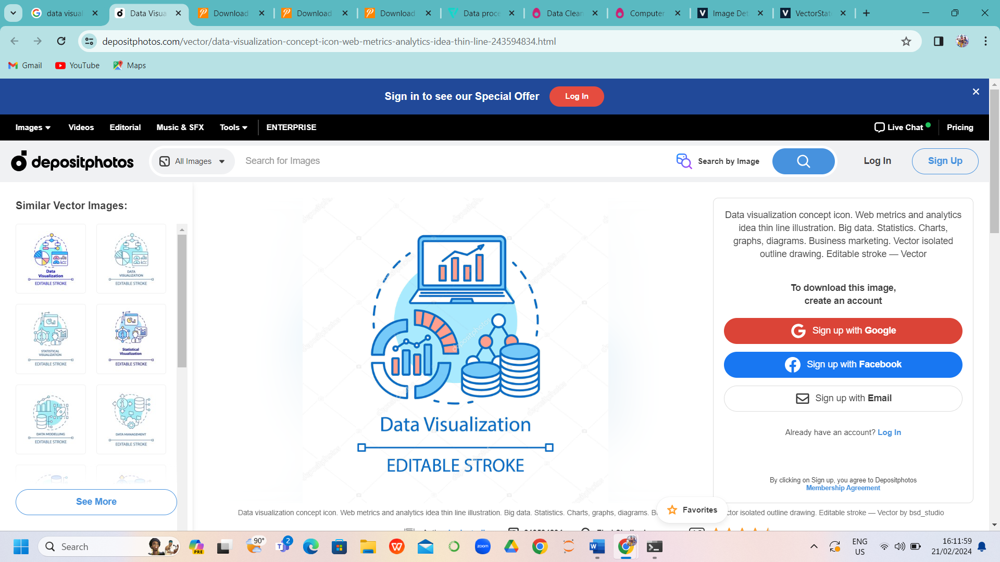
Project Architecture
Datasets
Import libraries
Read the datasets
Data cleaning
Missing Value Treatment
Checking duplicates
Data preprocessing/EDA
Rename Column names
Changes in the inappropriate blank values Construct an Extra column for the location,correlation
in the column
Data Visualization
Numerical Data Visualization,Heatmap
Barth Chart,Pie Chart,Bar Graph,Histogram
Outliers Detection through Boxplot

Slide 4
2. Project goal
The main objective is to create a recommendation system to recommend relevant books to users based on popularity and user interests.

Slide 5
3.Dataset Details
The dataset is comprised of 3 csv files: Users, Books, Ratings
Users_dataset:
User-ID(unique for each user)
Location(contains city,state and country separated by commas)
Age
Shape of Dataset -(278858,3)
Books_dataset:
ISBN(unique for each book)
image-URL-S ,M,L
Book-Title
Book-Author
Year-of-Publication
Publisher
Shape of Dataset-(271360,8)
Ratings_dataset:
User-ID
ISBN
Book-Rating
Shape of Dataset-(1149780,3)

Slide 6
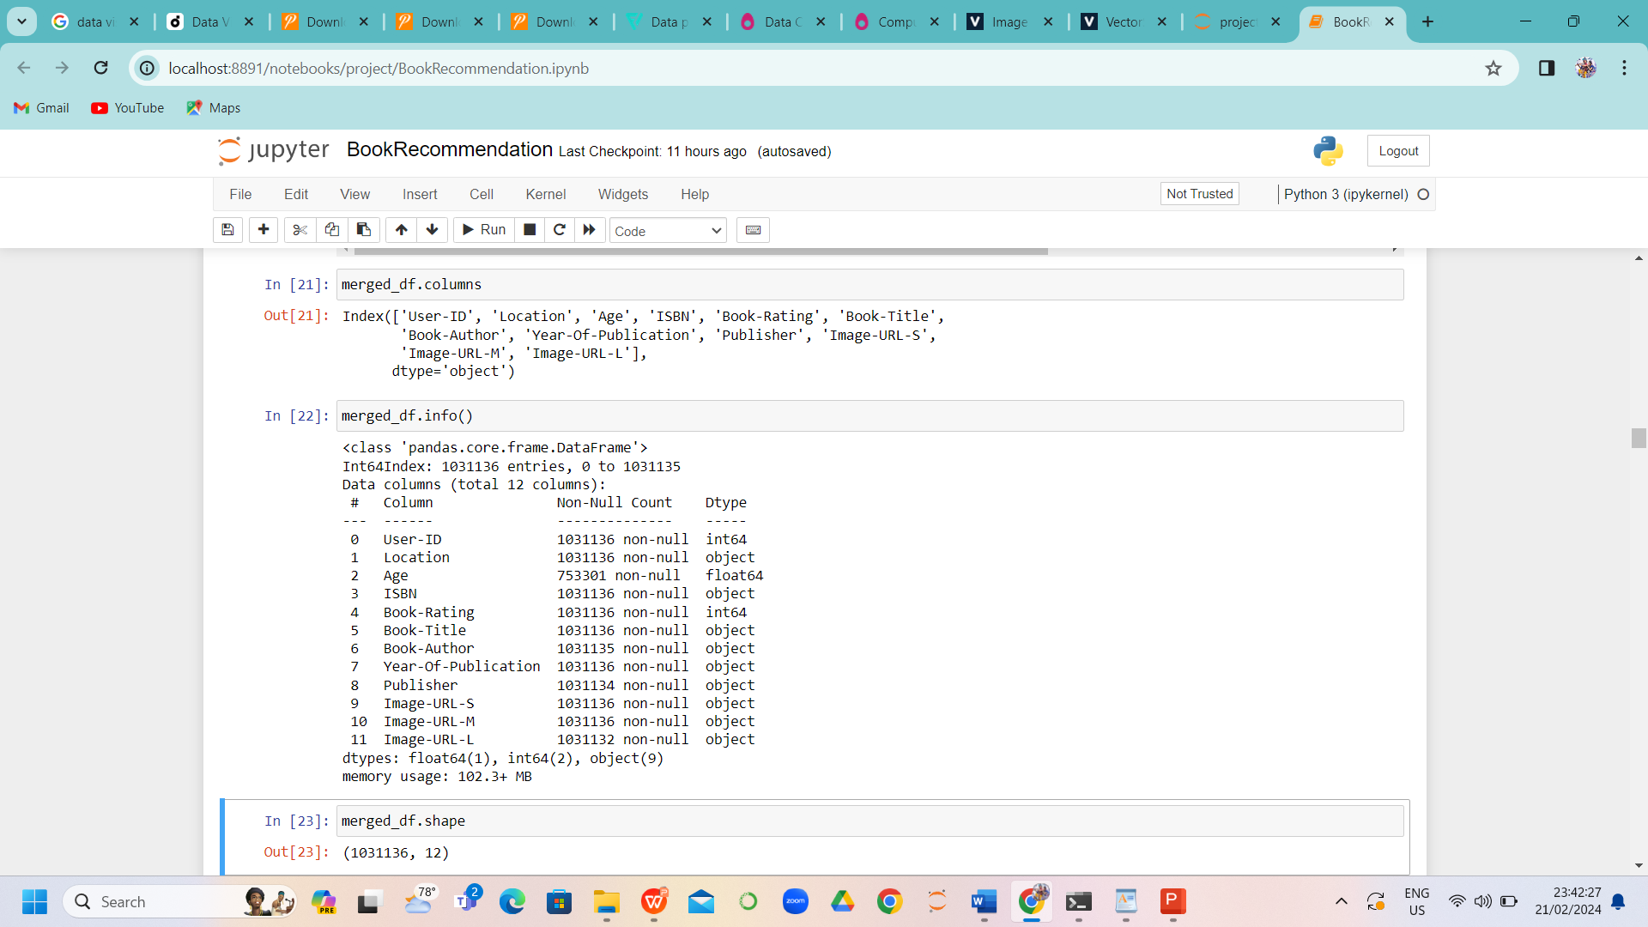
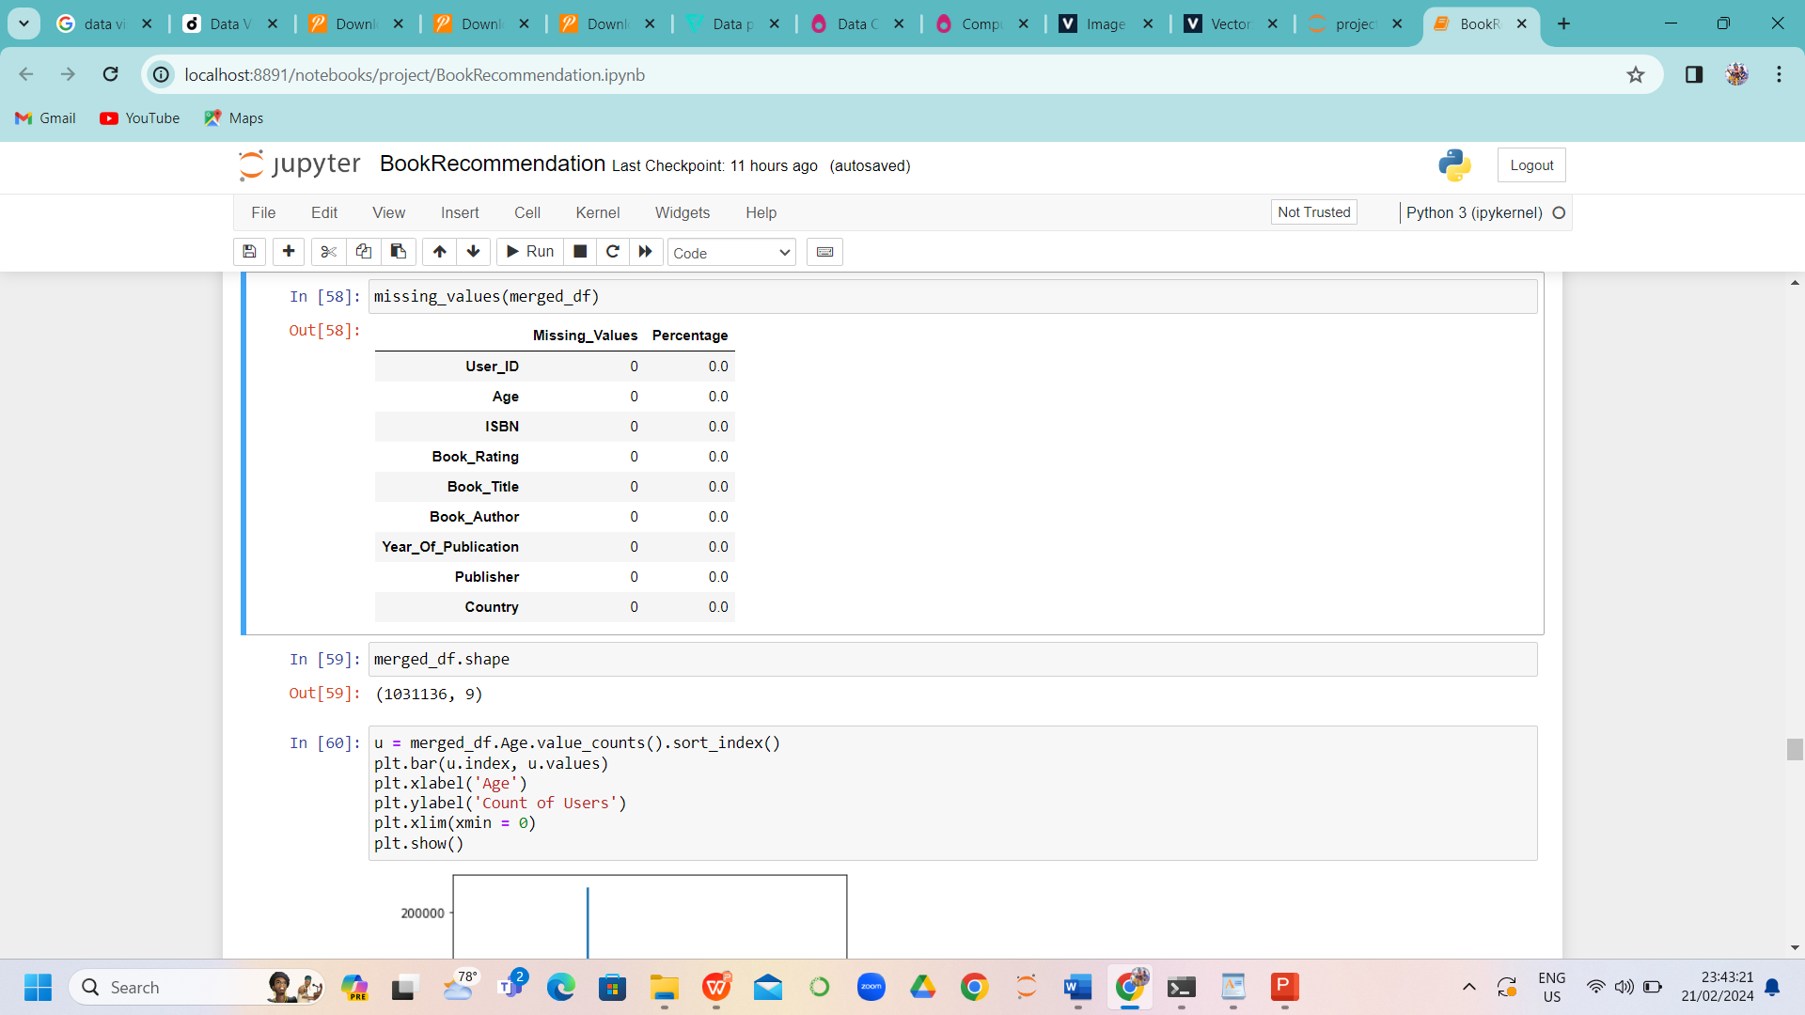
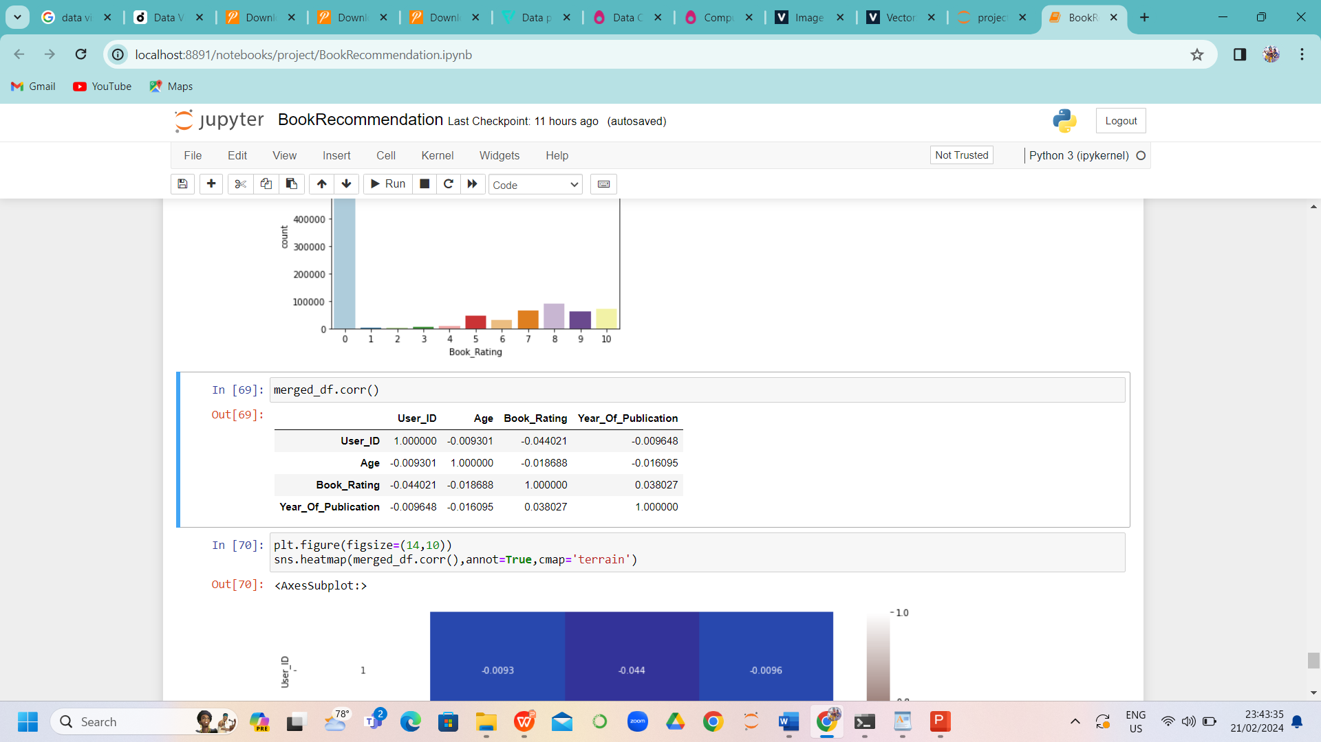
4. Data Preprocessing and EDA
Merged 3 datasets.
Column names:
'User_ID', 'Location', 'Age', 'ISBN', 'Book_Rating', 'Book_Title', 'Book_Author', 'Year_Of_Publication', 'Publisher'], dtype='object'
Droped “Image-URL-S', 'Image-URL-M', 'Image-URL-L” from merged_df dataset and replaced “country” by “location”
Identification and removal of null values
Correlation

Slide 7
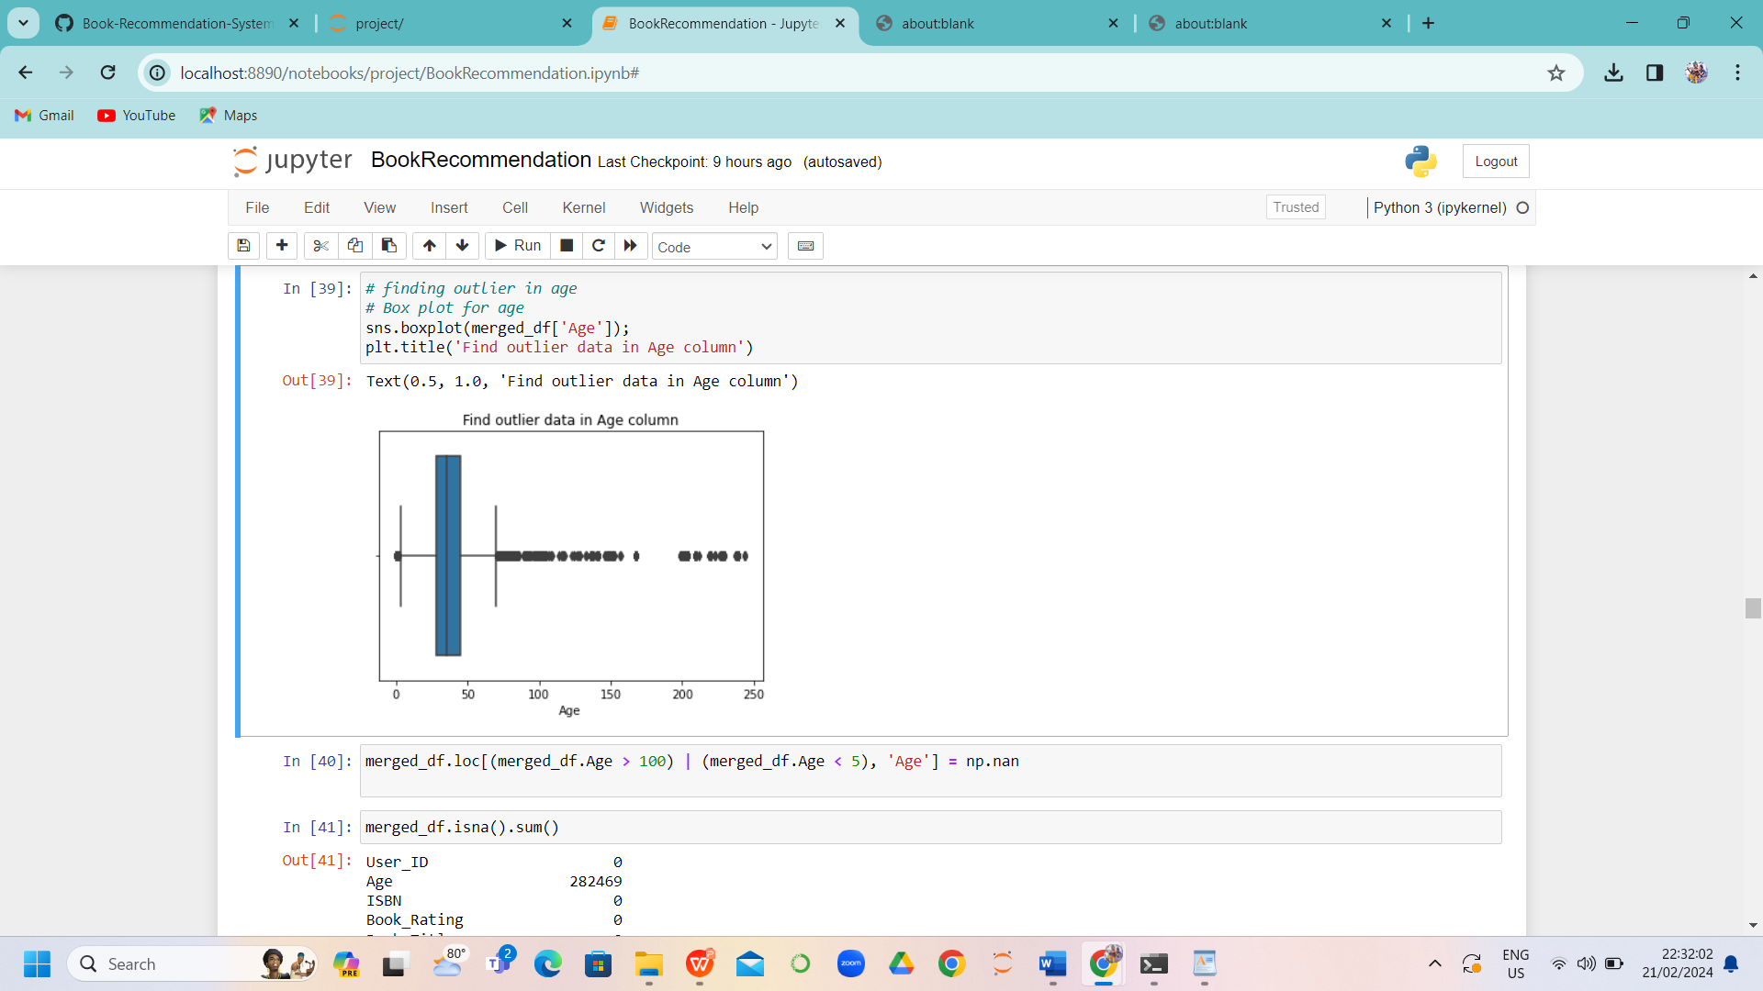
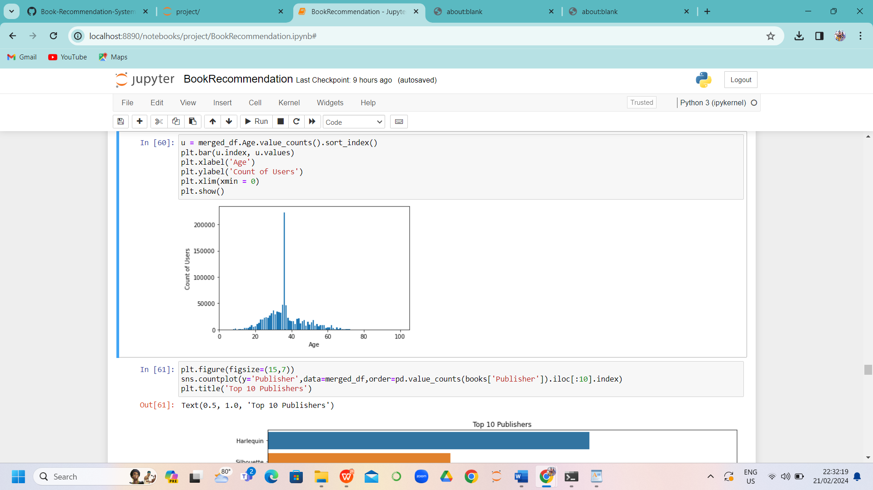
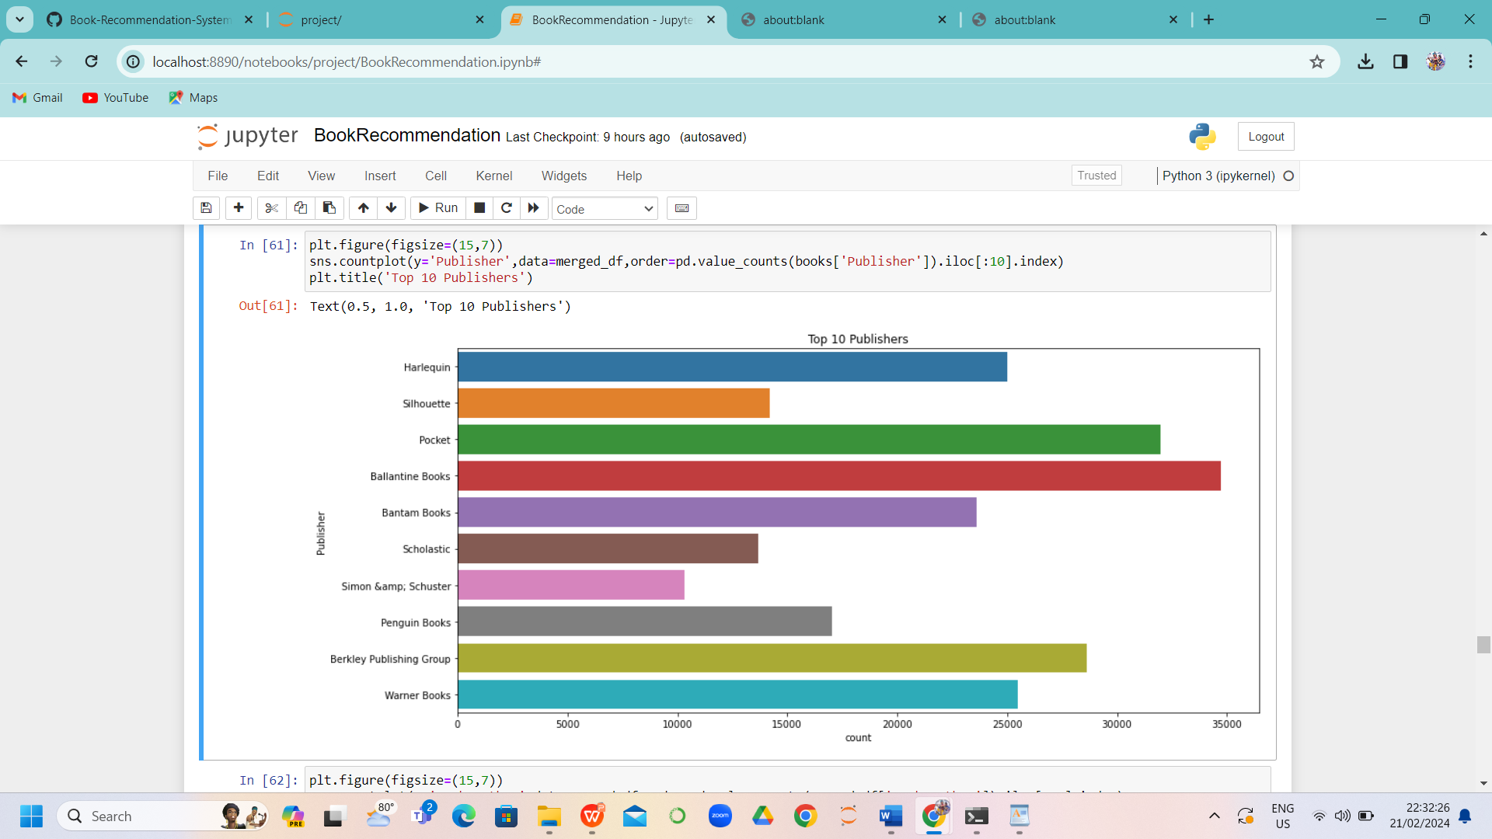
5. Visualizations
Boxplot(outliers identification)
Histogram
Top 10 Publishers
Age has positive skewness so we use mean to fill the nan values
maximum number of users are in between the age of 20-40
Ballentine books Published highest number of books

Slide 8
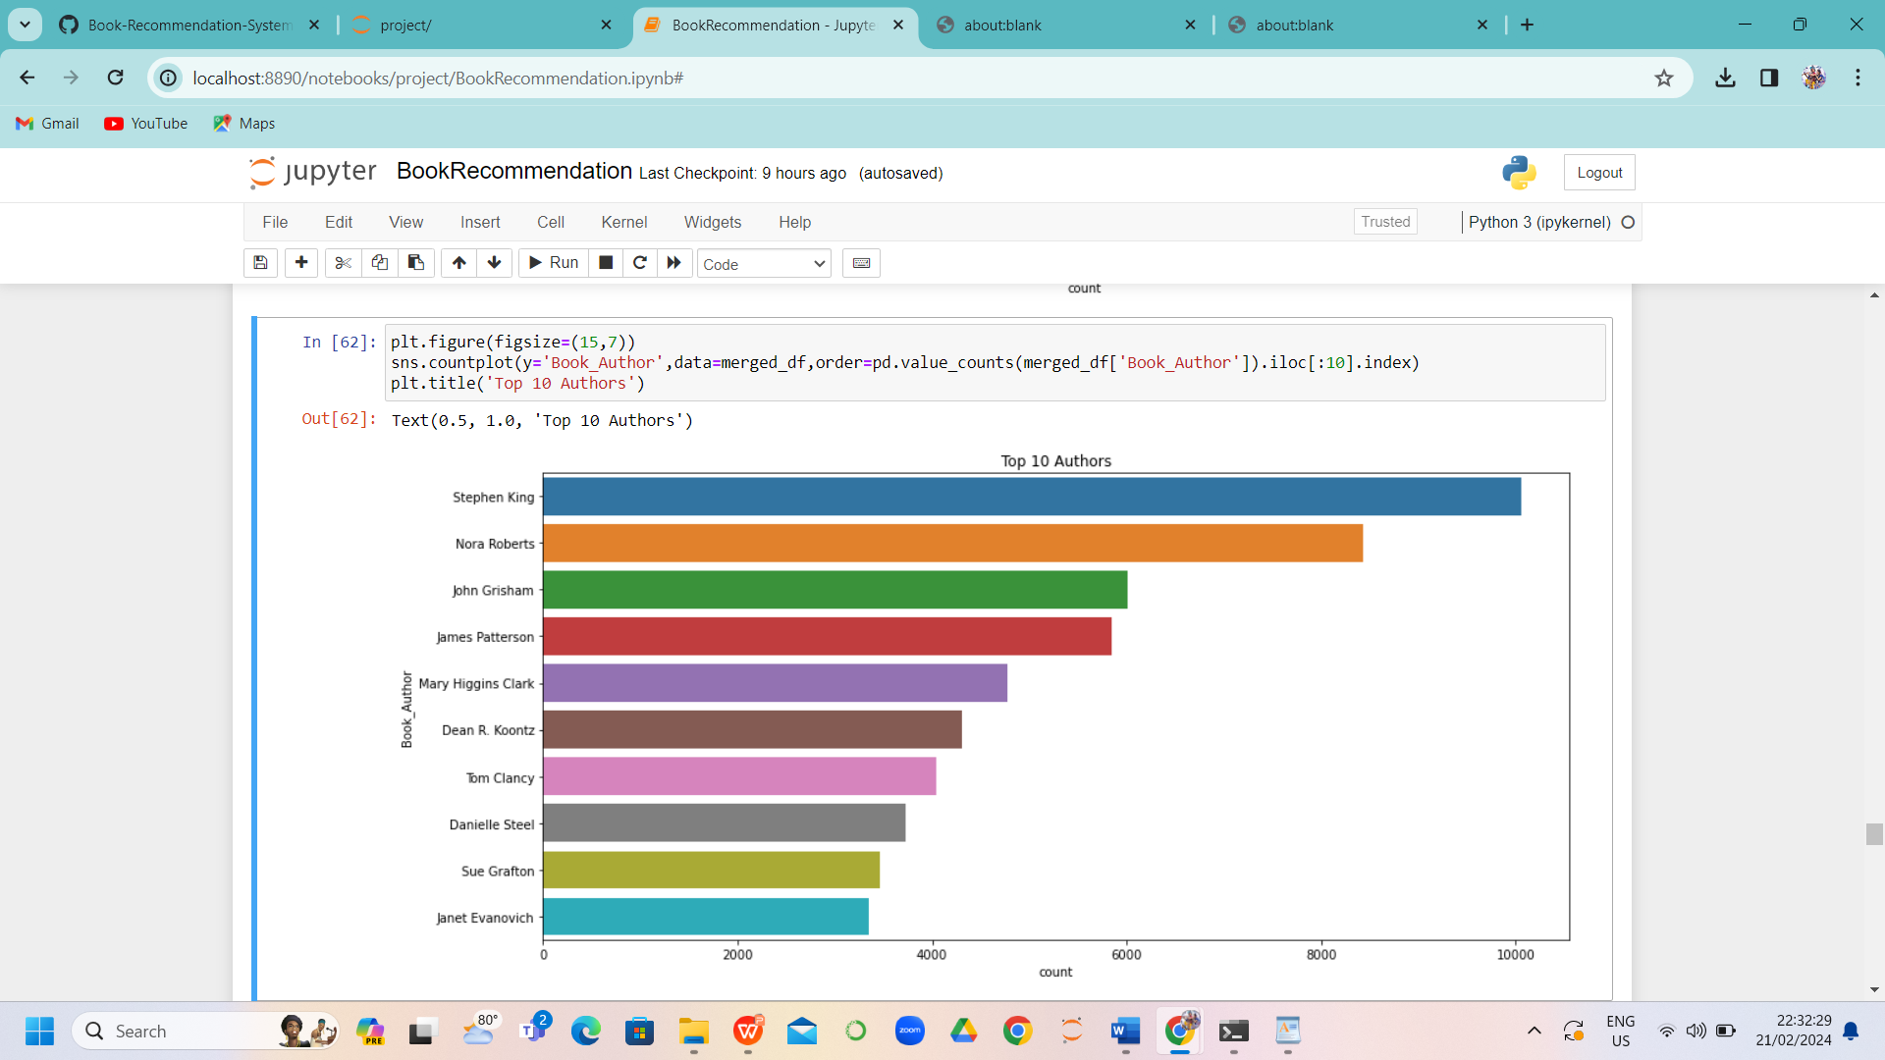
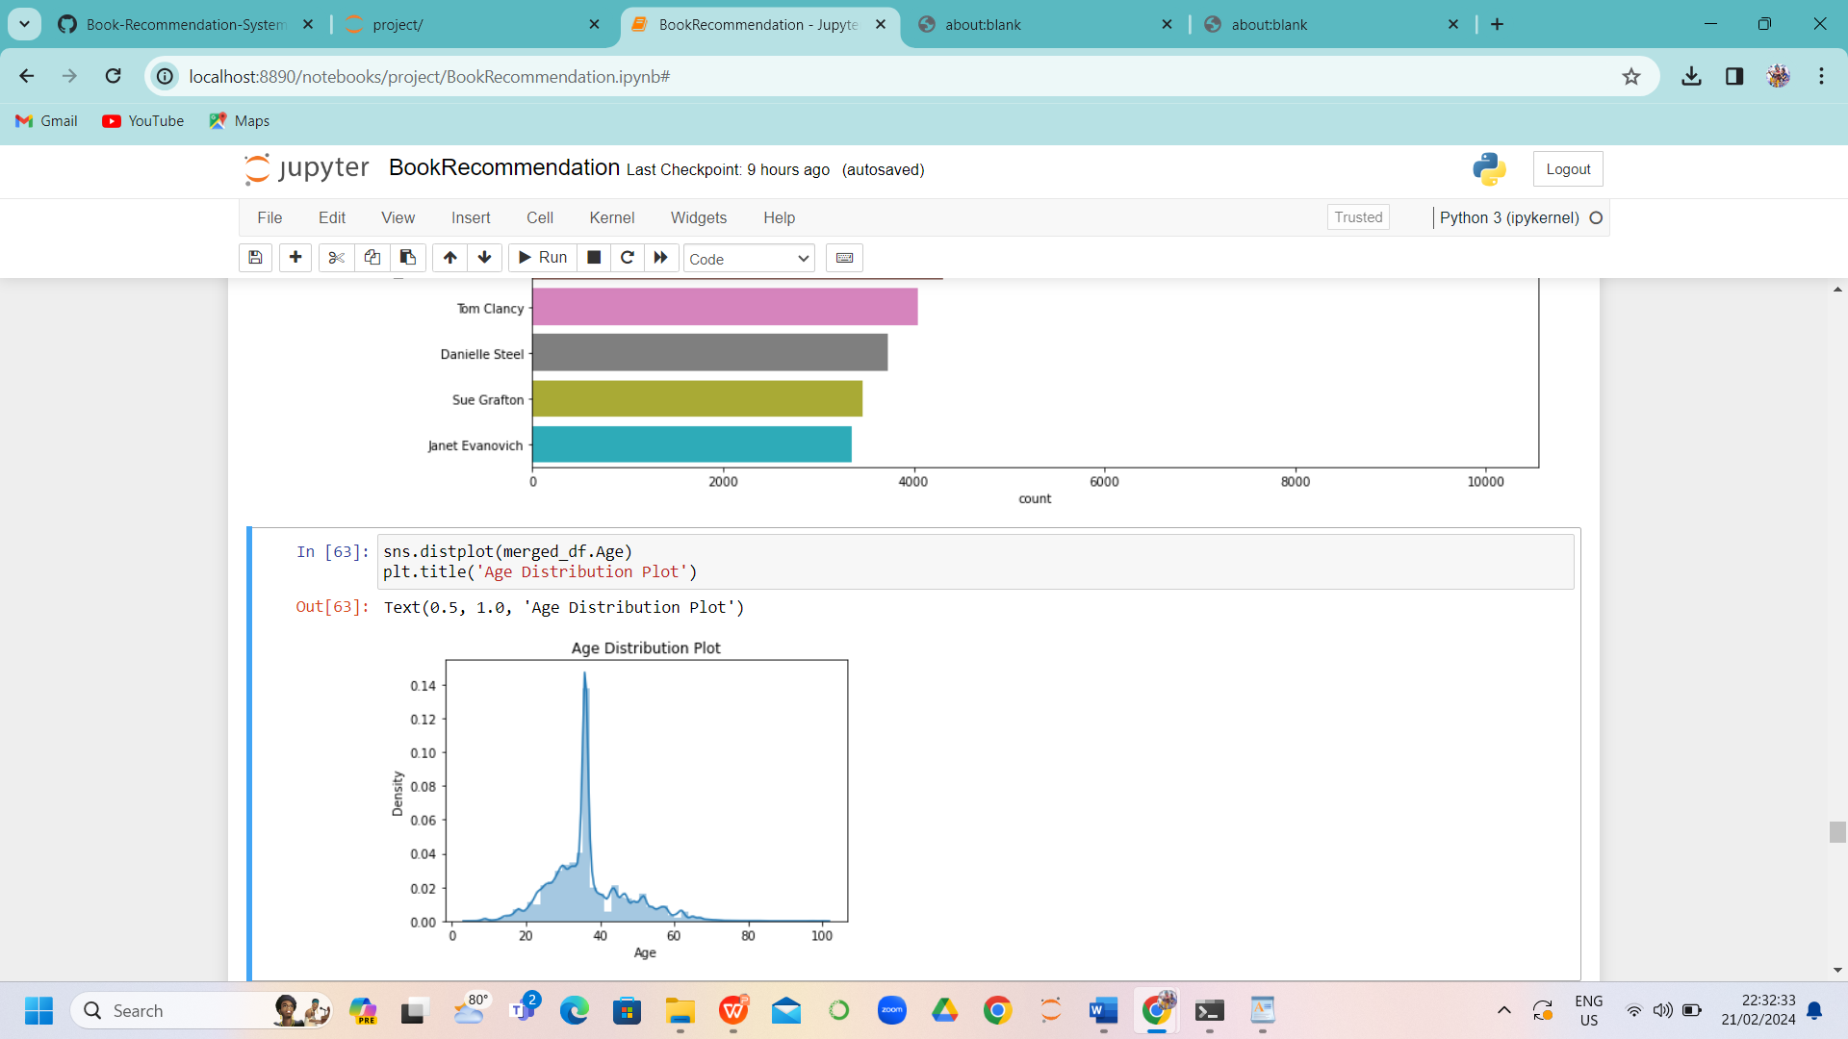
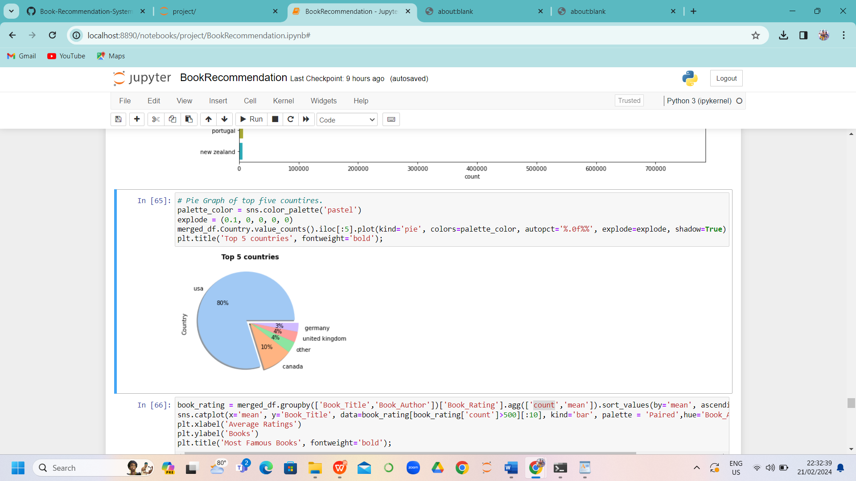
Top 10 Authors
Distribution plot
Pie-chart
Stephen King wrote the highest number of books
Maximum age distribution is in between 20-40 with density 0.14
Most of the users are from USA(80%)

Slide 9
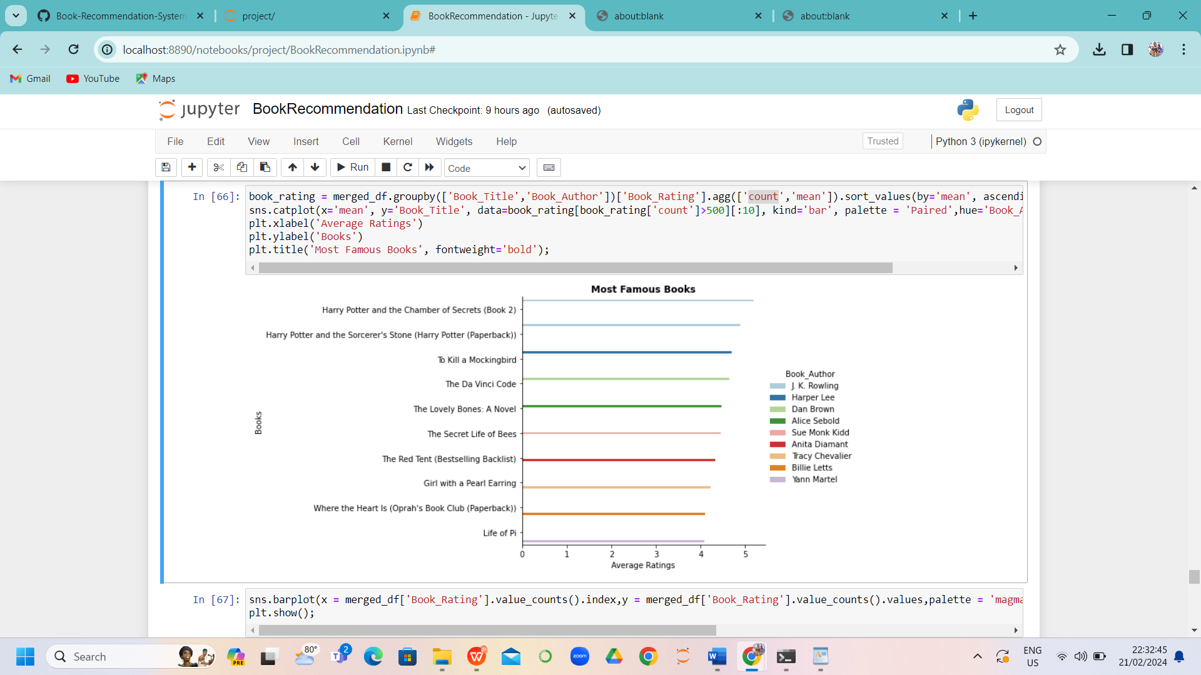
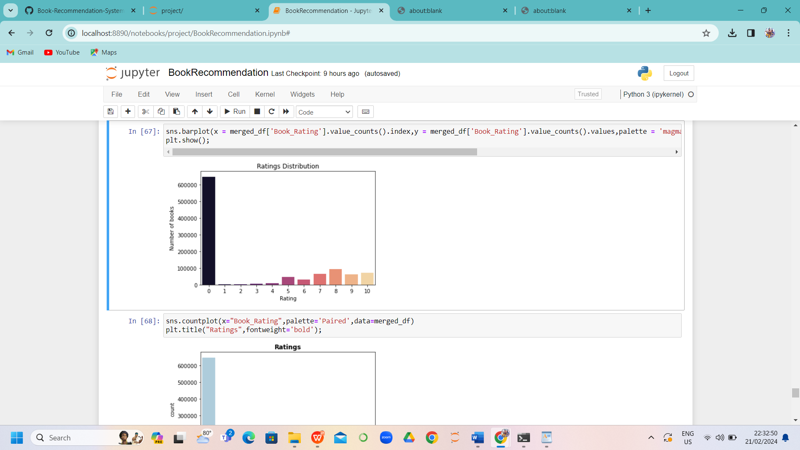
Graphical representation of Most famous books
Rating distribution
Harry Potter and the chambers of Secrets books by J K Rowling is identified as the most underrated book
There are more than 6,00,000 books identified as 0 rating

Slide 10
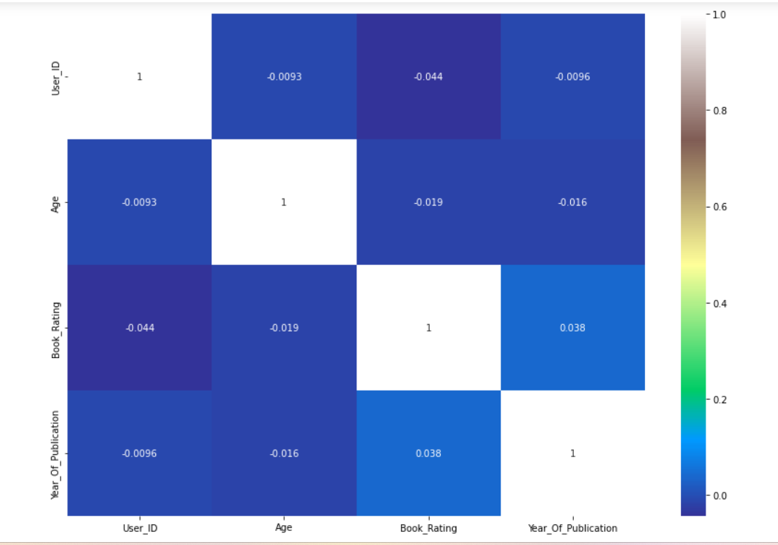
Heat map
Overall report
Outliers are right skewed
maximum number of users are in between the age of 20-40
Harry Potter and the chambers of Secrets books by J K Rowling is identified as the most underrated book
Stephen King wrote the highest number of books
Ballentine books Published highest number of books

Slide 11
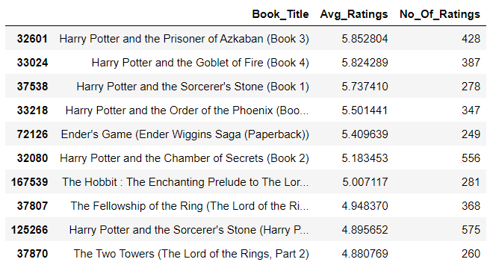
Popularity based Recommenders system
Filters used :
No of ratings >200
Based on no. of Ratings top 10 popular books are been filtered

Slide 12
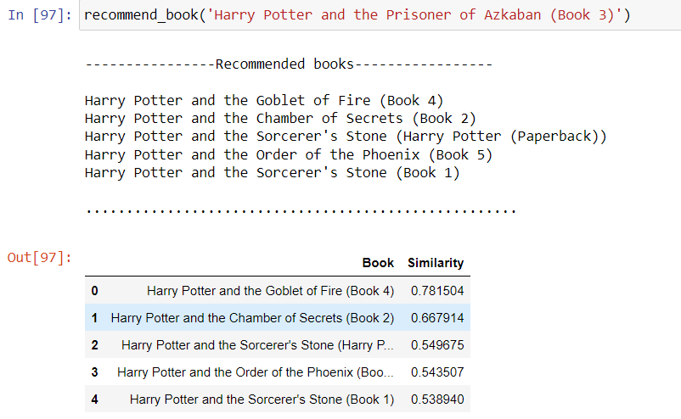
Item based collaborative filterings
Similarity sores have been generated
For the recommended books using cosine Similarity, and based on these scores , The related books are displayed

Slide 13

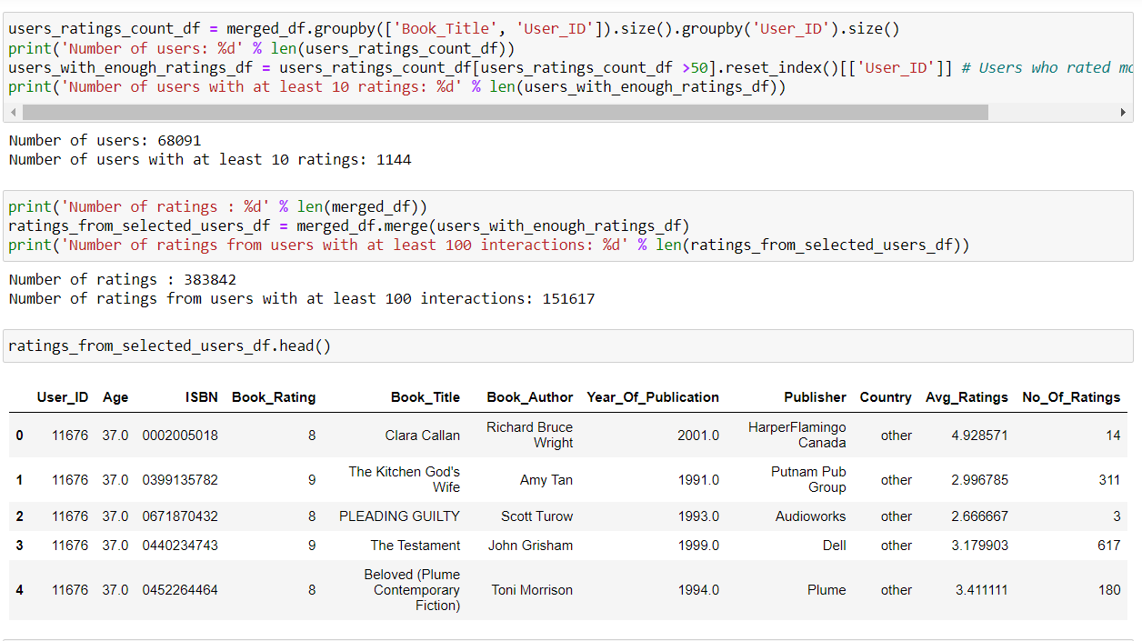
User based collaborative filterings

Slide 14
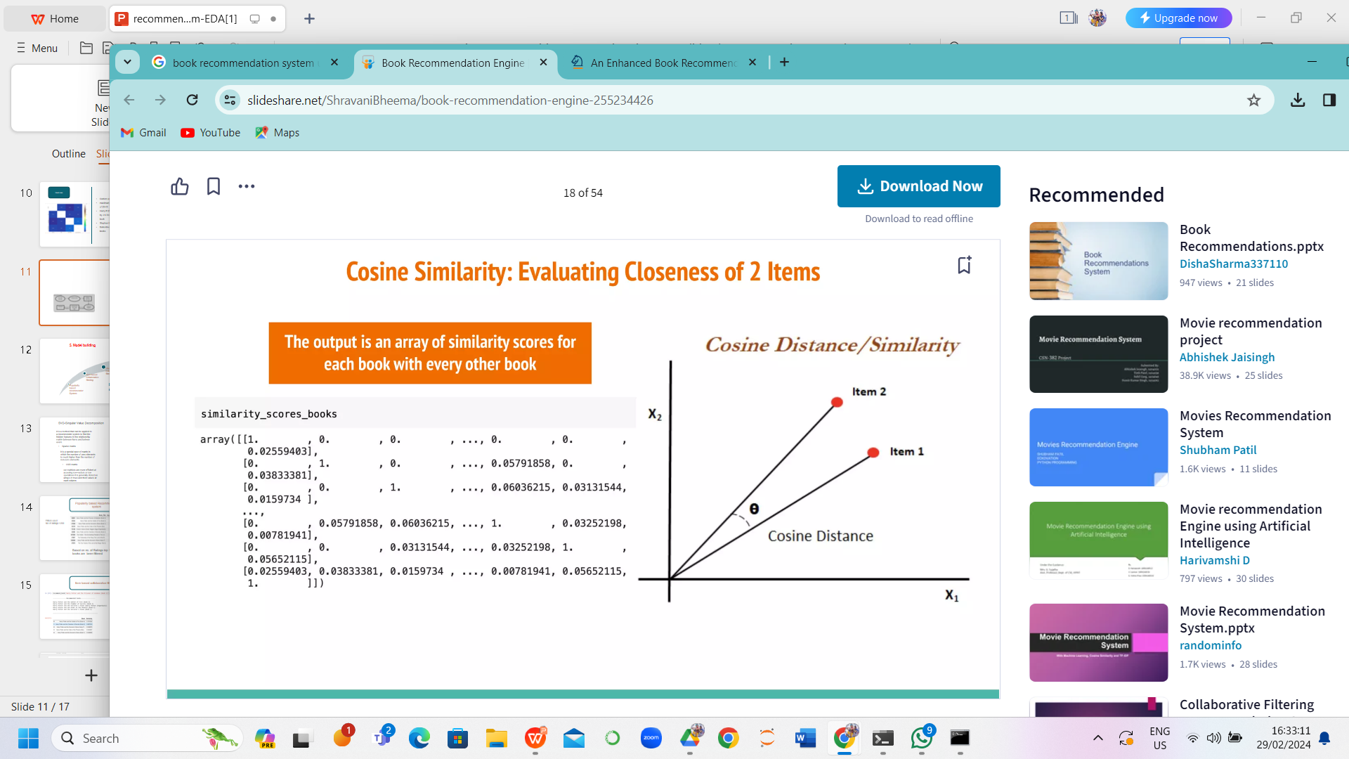
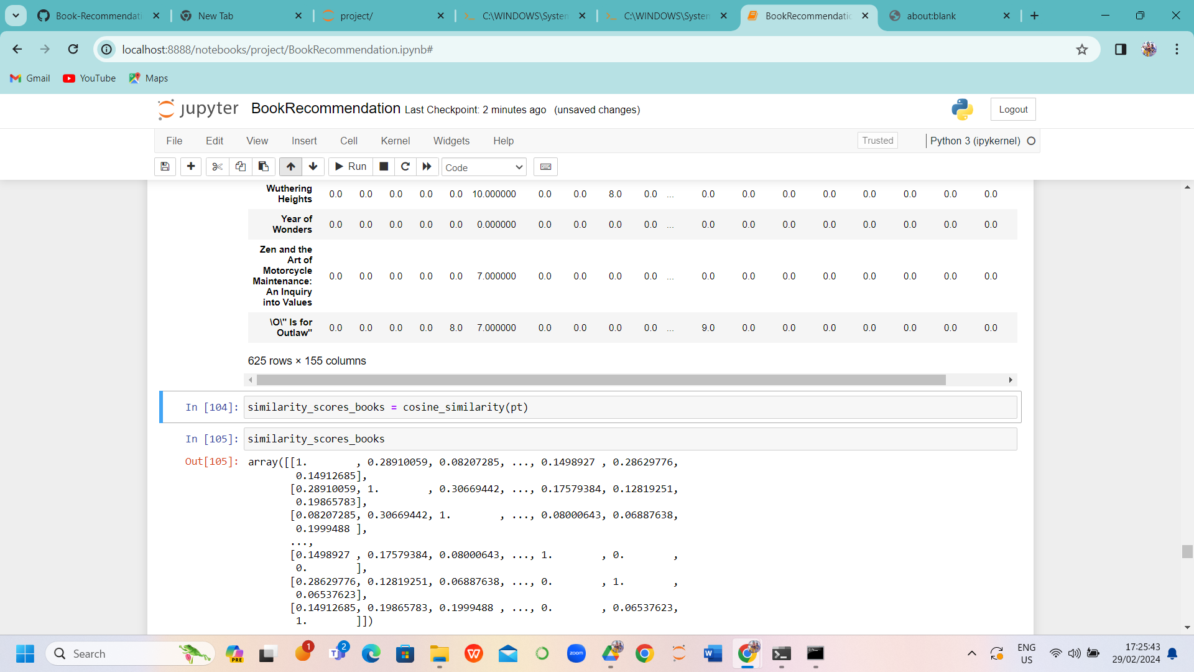

Slide 15
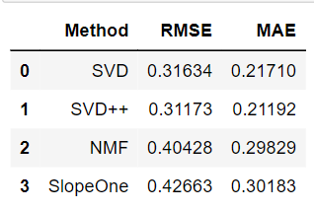
MODEL EVALUATION
collaborative filtering
Model based
Tabular representation of RMSE and MAE of different collaborative filtering algorithms
Matrix factorization(SVD)
NMF
Develop recommendation systems
SVD++
Slopeone
Evaluation
MAE
RMSE

Slide 16
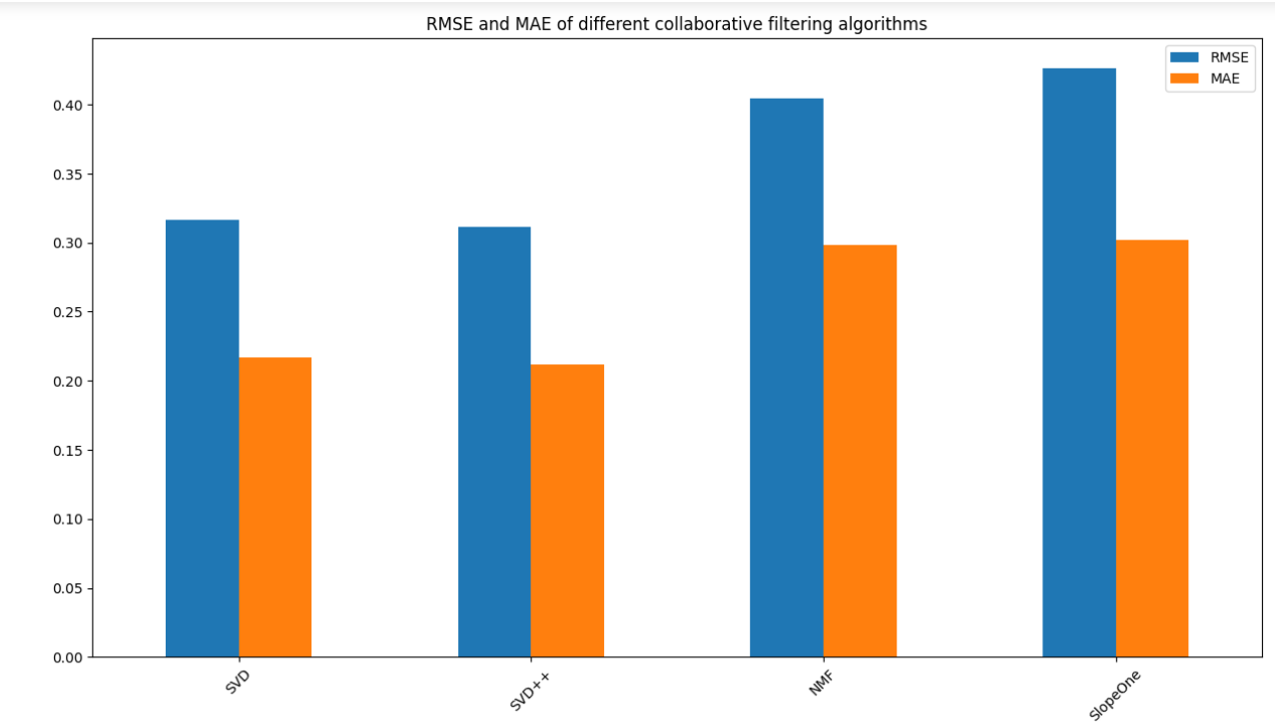
Graphical representation of RMSE nad MAE of different collaborative filtering algorithms
Thank you

Slide 17
Overall report
Outliers are right skewed
maximum number of users are in between the age of 20-40
Harry Potter and the chambers of Secrets books by J K Rowling is identified as the most underrated book
Stephen King wrote the highest number of books
Ballentine books Published highest number of books
Book-Ratings are negatively distributed with median rating of 8.
Root mean squared error of model SVD is 0.31 and mean absolute error is 0.21
Root mean squared error of model NMF is 0.34 and mean absolute error is 0.24
Root mean squared error of model SlopeOne is 0.39 and mean absolute error is 0.27
SVD++ is the best recommendation model with root mean squared error of 0.30 and mean absolute error of 0.20

Slide 18
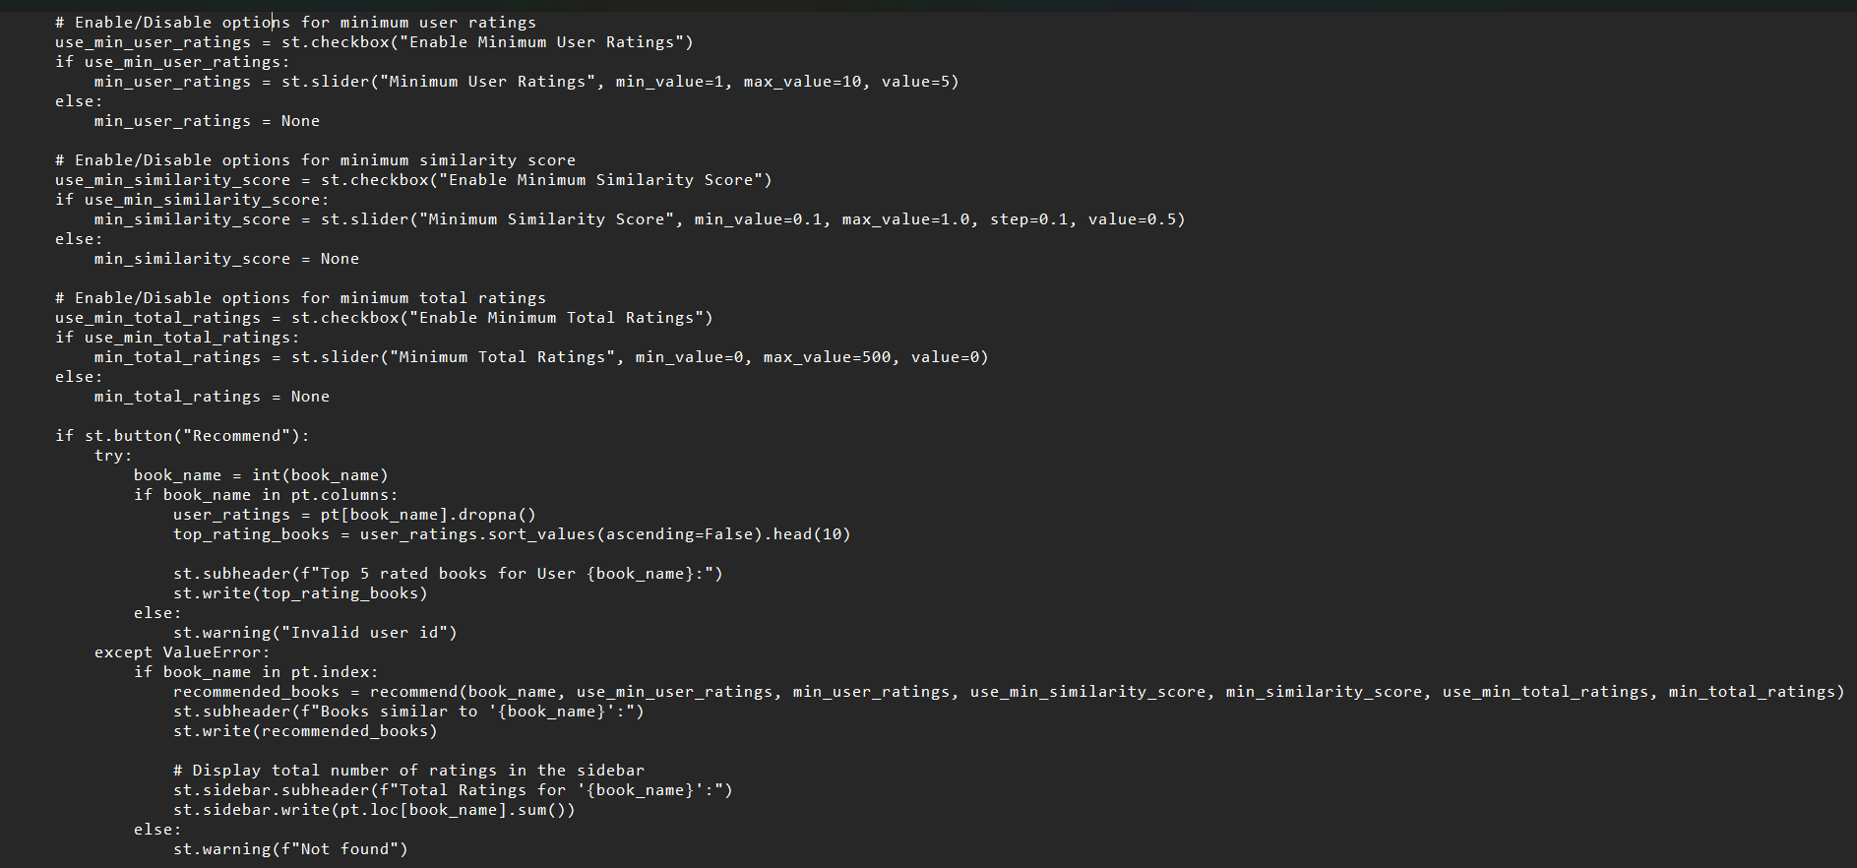
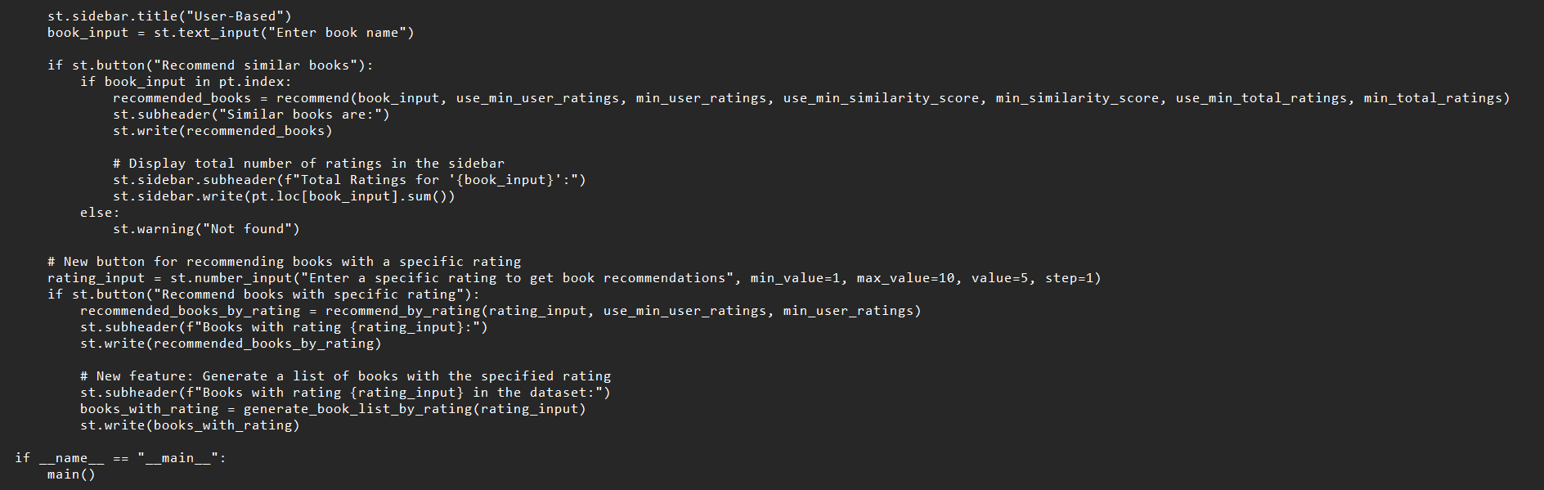
Using streamlit we have deployed our application

Slide 19
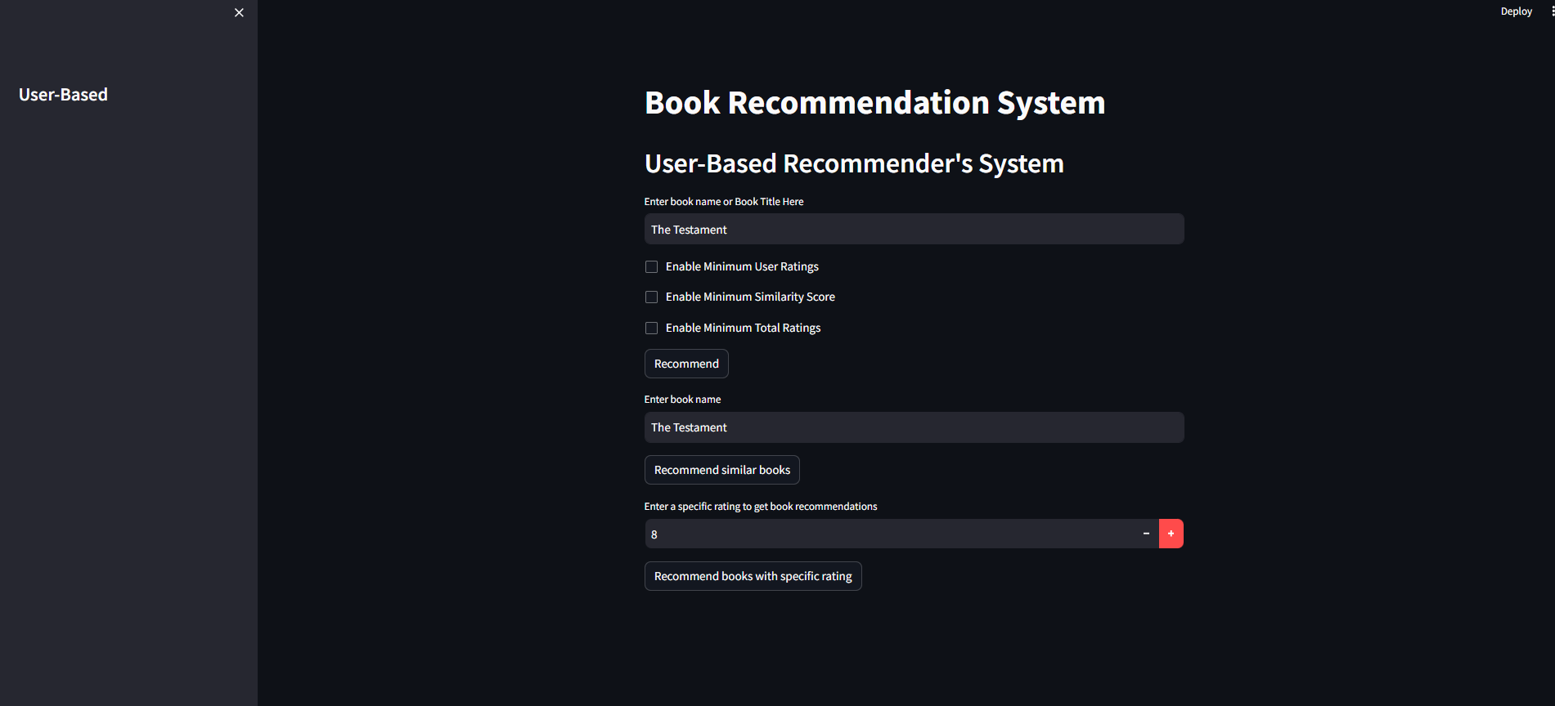
MODEL DEPLOYMENT INTERFACE

Slide 20
CHALLENGES IN THE PROJECT
In Start, We face difficulty with the dataset ,we have three datasets in that multiple columns are interlinked with each other.
In that pre-processed data we found the relationship between variables. EDA is an interesting part but the selection of variables and making more effective visualization is quite a tough task.
A most difficult task for the team to build an accurate model and to evaluate we used SVD(SVD++, NMF) and Slopeone to get RMSE and MAE Values
In deployment, we learned streamlit and Python for making a good interface. It takes time and continuous discussion in the team and we did make a great app page.

Slide 21
Thank you

